Slide 1
Reality Bytes
Using Wireshark to Analyze Vulnerable Networks
Reality Bytes

Slide 2
Table of Contents
This document contains the following resources:
Critical Vulnerabilities
Traffic Profile
Behavioral Analysis
Malicious Activity for Various Network Topologies
TOC

Slide 3
Critical Vulnerabilities
3

Slide 4
Critical Vulnerabilities: Three Scenarios
A Wireshark assessment uncovered the following points of failure:
Vulnerability | Description | Impact
Malware Downloads | Trojan retrieved from malicious link | Data Breach / Potential DDoS Attack
Infected Hosts | Windows PC in contact with foreign IP address | Loss of Privacy / Impaired Performance or Function
Illegal Torrents | Improper downloads of unauthorized movie files | Copyright Infringement

Slide 5
Traffic Profile
5

Slide 6
Common Protocols
The analysis identified the following characteristics of traffic on the network:
Feature | Value | Description
Transmission Control Protocol | TCP | Enables application programs and computing devices to exchange messages over a network
Hypertext Transfer Protocol | HTTP | Intended for distributed media systems that allows users to communicate data on the World Wide Web
Server Message Block | SMB2 | Allows applications on a computer to read and write files as well as request services from a computer network
Kerberos | KRB5 | Authenticates service requests between trusted hosts across an untrusted network
NetBIOS Name Server | NBNS | A Windows computer uses this to look up a host on the internal network when an IP address cannot be resolved through organizational DNS

Slide 7
Behavioral Analysis
7

Slide 8
Behavioral Analysis
Purpose of Traffic on the Network
Users were observed engaging in the following kinds of activity:
“Normal” Activity
TCP to establish and maintain connections
LDAP (Microsoft Active Directory) to process domain authentication requests
Suspicious Activity
HTTP GET requests to download illegal or malicious payloads
SMB allowed the discovery of an unapproved domain policy
Presence of less secure NBNS (NetBIOS) can be a potential avenue for Man-in-the-Middle attacks

Slide 9
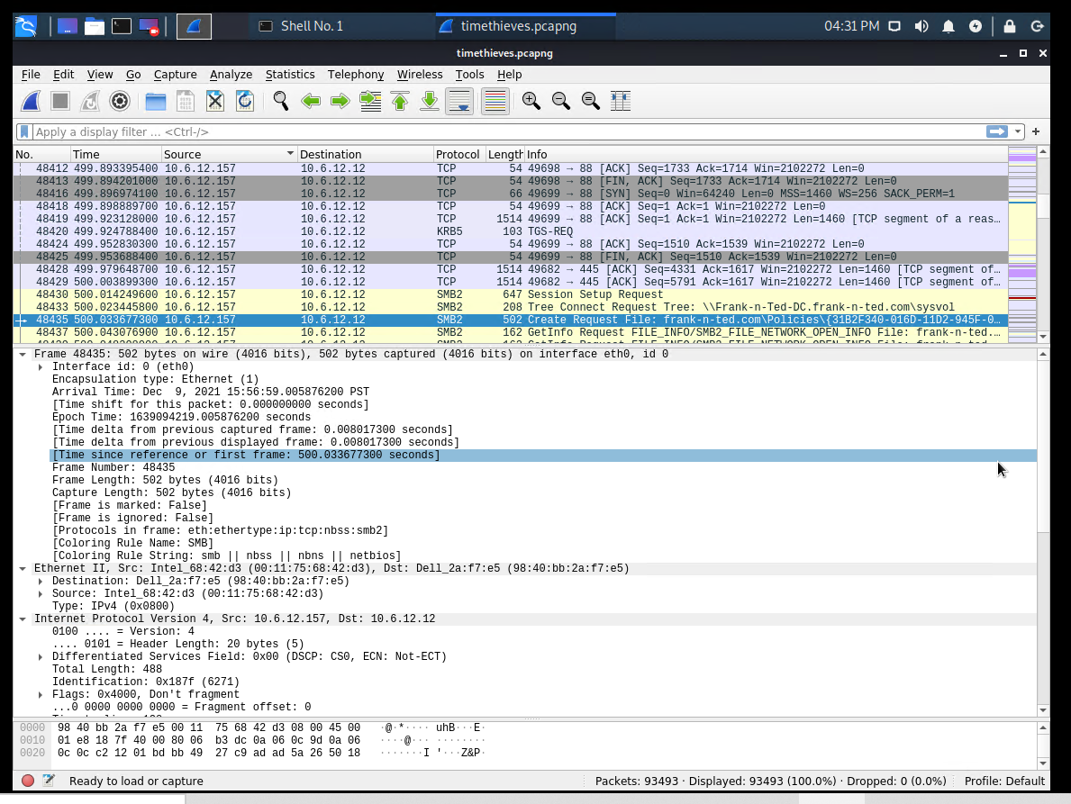
Domain Discovery
When “Normal” Goes Rogue
SMB requests betrayed the presence of an unexpected domain controller
A policy inquest was issued to the DC at frank-n-ted.com
The corresponding policy ID is denoted in the screenshot below:
frank-n-ted.com

Slide 10
Malicious Activity
10

Slide 11
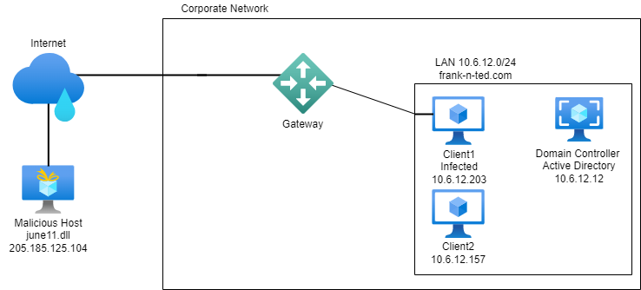
Network Topology (Malware Attack)
Network
Address Range: 10.6.12.0-255
Machines
IPv4: 10.6.12.12
OS: Windows Sever
Hostname: frank-n-ted-DC
IPv4: 10.6.12.157
OS: Windows
Hostname: (Client2)
IPv4: 10.6.12.203
OS: Windows
Hostname: (Client1)
IPv4: 205.185.125.104
OS: Unknown
Hostname: (Malicious Host)
Malicious Host

Slide 12
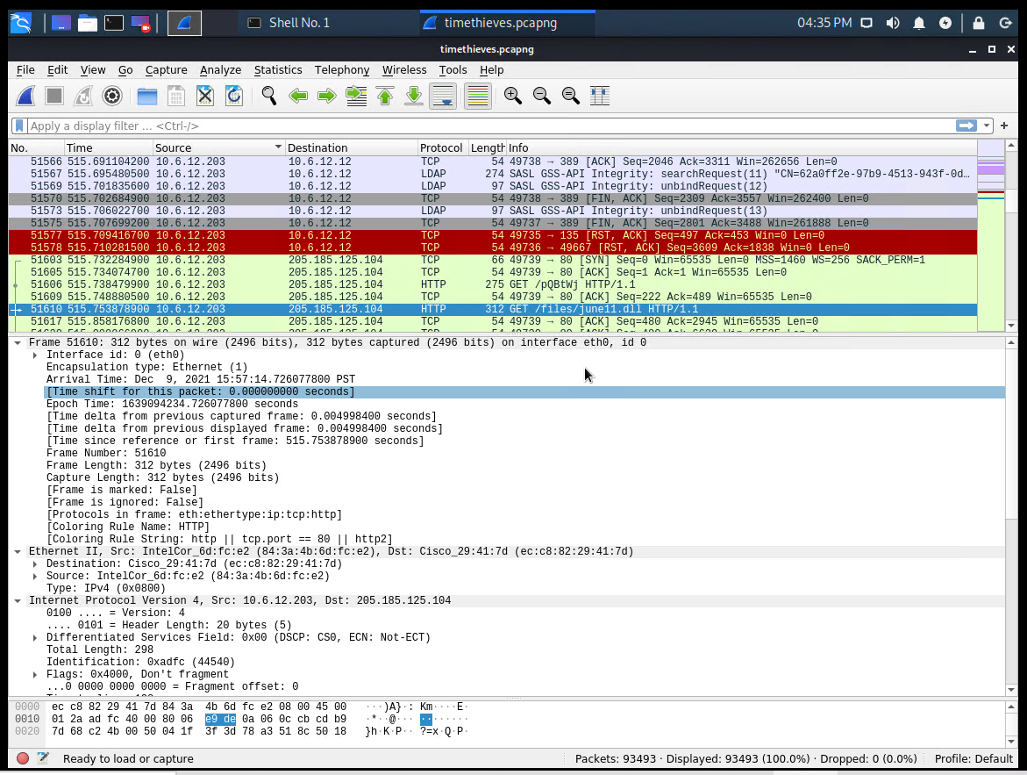
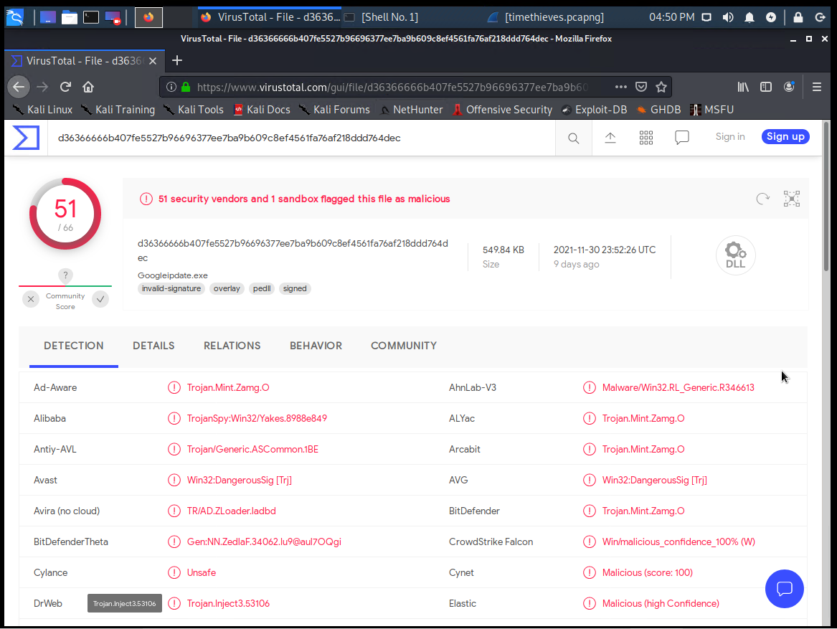
Malware BITES
Summary
HTTP traffic was observed, specifically a GET request
Client 10.6.12.203 was joined to a rogue domain and accessing the Internet to download a malicious payload
Trojan june11.dll was captured and identified by VirusTotal.com
june11.dll, VirusTotal.com

Slide 13
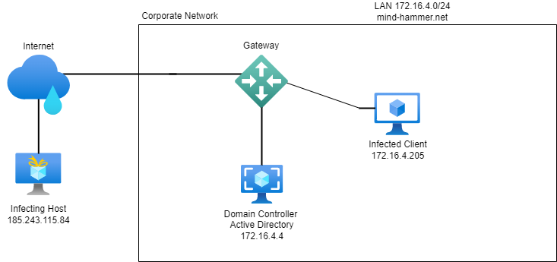
Network Topology (Host Infection)
Network
Address Range: 172.16.4.0-255
Broadcast: 172.16.4.255
Gateway: 172.16.4.1
Machines
IPv4: 172.16.4.4
OS: Windows Server
Hostname: Mind-Hammer-DC
IPv4: 172.16.4.205
OS: Windows
Hostname: ROTTERDAM-PC
Username: matthijs.devries
IPv4: 185.243.115.84
OS: Windows
Hostname: b5689023
Infected PC

Slide 14
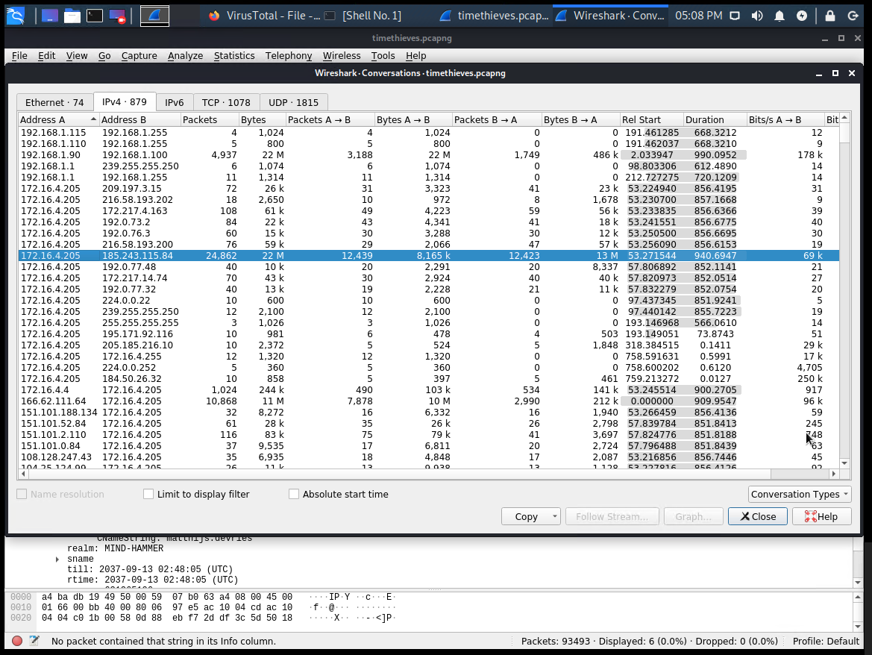
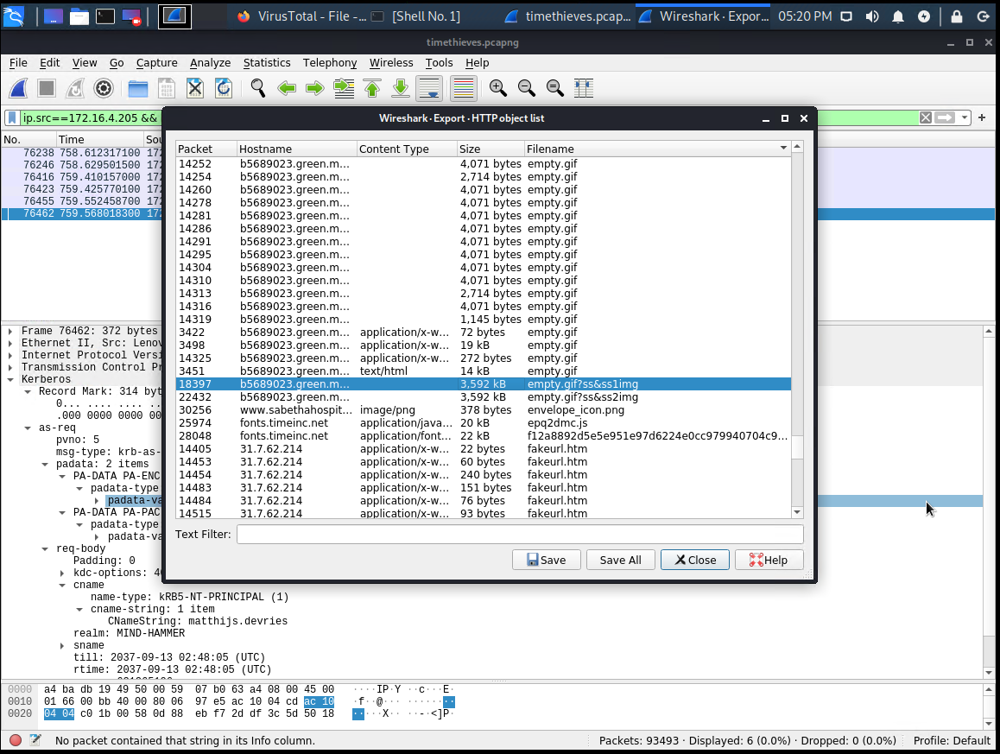
Infected Hosts
Summary
Infected Windows PC and IP address was identified on the network (172.16.4.205)
A high volume of traffic was indicated between the infected client and a foreign host
A Wireshark HTTP object export captured a desktop image from the infecting PC
Conversations, HTTP Object Export

Slide 15

Network Topology (Downloading Movies)
Network
Address Range:
10.0.0.0-255
Machines
IPv4: 10.0.0.2
OS: Windows Server
Hostname: DogOfTheYear-DC
IPv4: 10.0.0.201
OS: Windows
Hostname: BLANCO-DESKTOP
Username: elmer.blanco
IPv4: 168.215.194.14
OS: Unknown
Hostname: (Torrent Tracker)
Illegal Torrents

Slide 16
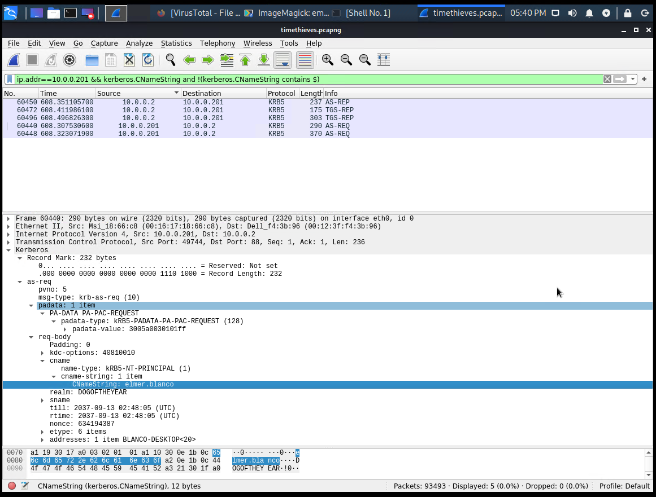
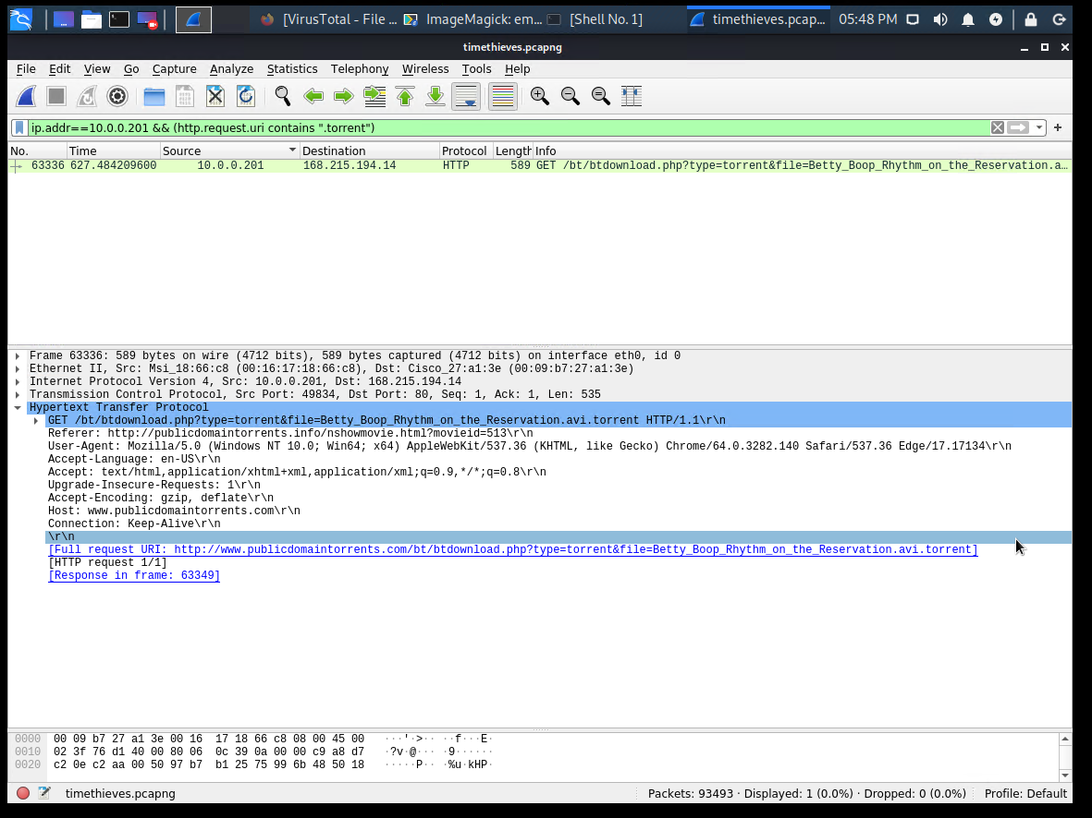
Illegal Torrents
Summary
Client 10.0.0.201 authenticated to the domain controller with username and host credentials (See identifying Kerberos NameString below)
An HTTP GET request was initiated for the AVI download (Audio Video Interleave file)
CNameString, Betty Boop - Rhythm on the Rez

Slide 17
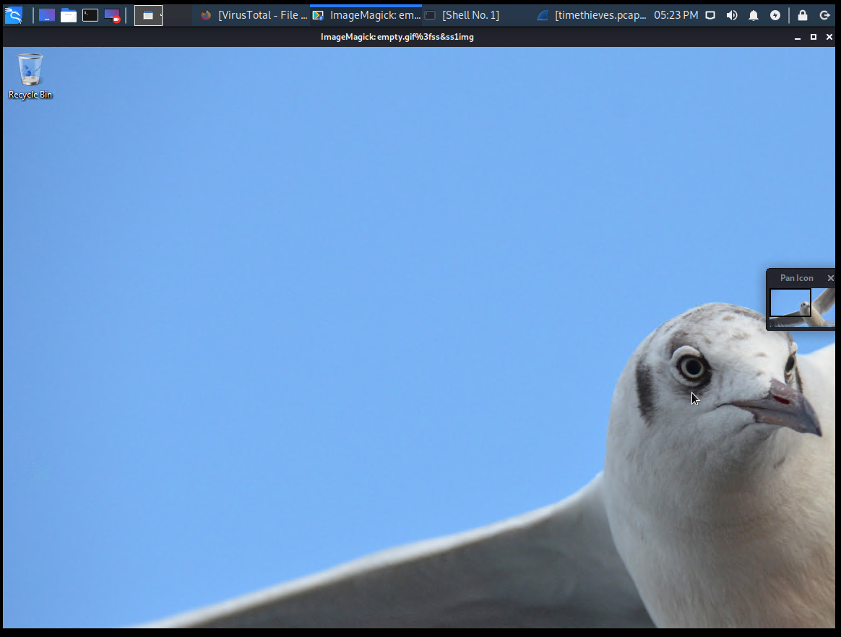
FIN
17

